Slide 1
Advanced Python Programming
Week 9: The Factory Pattern and Builder Pattern (Ch 16-17)

Slide 2
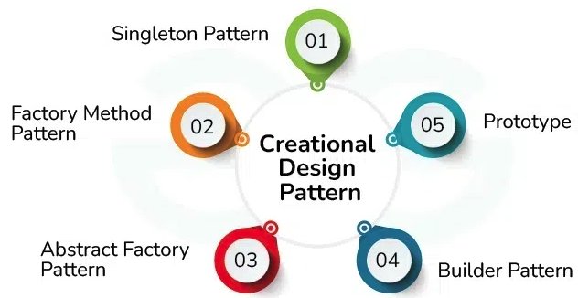
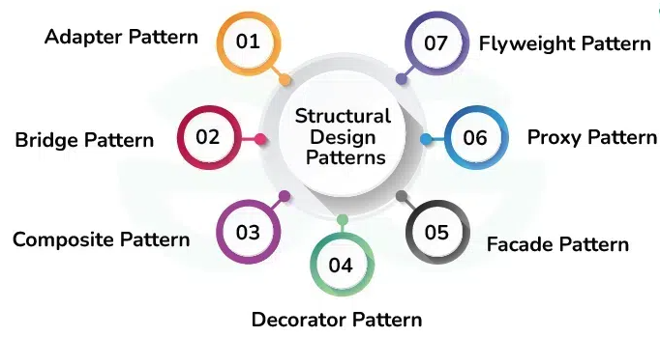
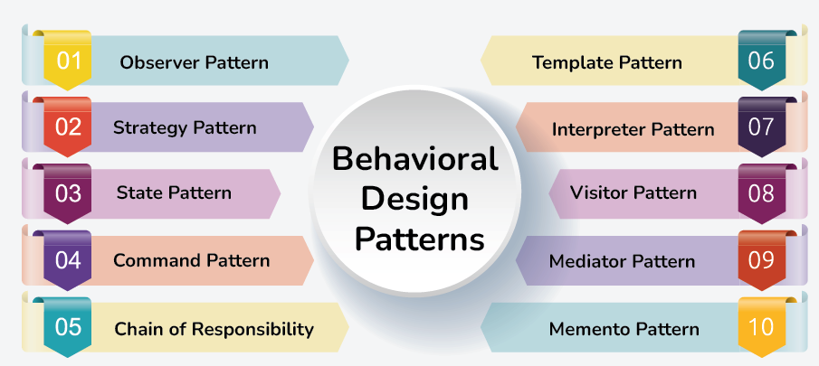
Design Patterns
A design pattern is a generic repeatable solution to frequently occurring problem in software design.
It’s a description or model for problem-solving that may be applied in various contexts.
Creational design patterns: a subset of design patterns that deal with the process of object creating, trying to make it more flexible and efficient.
Structural design patterns: a subset of design patterns that focus on the composition of classes and objects to form larger, more complex structures, helping to organize and manage relationships between objects to achieve greater flexibility, reusability and maintainability.
Behavioral design patterns: a subset of design patterns that deal with communications and interactions between objects and classes, focusing on how objects and classes collaborate and communicate to accomplish tasks and responsibilities.

Slide 3
When to Use Design Patterns
Recurring Problems: When you encounter recurring design problems that have well-established solutions, design patterns provide tested and proven approaches to common software design challenges.
Flexibility and Reusability: Use design patterns to promote code reusability, flexibility, and maintainability. They help in structuring code in a way that makes it easier to modify and extend as requirements evolve.
Design Principles: Use design patterns to apply fundamental design principles such as separation of concerns, encapsulation, and dependency inversion. They help in achieving better modularity and reducing dependencies between components.
Communication: Use design patterns to improve communication among team members. Design patterns provide a common vocabulary and understanding of how to solve particular problems, facilitating collaboration and code comprehension.
Performance: In some cases, design patterns can improve performance by optimizing resource usage, reducing overhead, or improving code execution efficiency.

Slide 4
When not to Use Design Patterns
Over-Engineering: Avoid using design patterns unnecessarily, especially for small or simple problems. Over-engineering can lead to unnecessary complexity and overhead, making code harder to understand and maintain.
Premature Optimization: Avoid using design patterns solely for the sake of optimization before performance issues are identified. Premature optimization can lead to added complexity without significant benefits and can hinder future changes.
Unfamiliarity: Avoid using design patterns if you or your team are unfamiliar with them or if their application does not align with the problem at hand. Using patterns incorrectly can lead to misuse and potential design flaws.
Project Constraints: Consider project constraints such as time, budget, and team expertise. If applying a design pattern significantly increases development time or introduces unnecessary complexity, it may not be appropriate for the project.
Changing Requirements: Be cautious when applying design patterns in highly dynamic environments where requirements frequently change. Overly rigid designs based on patterns may struggle to adapt to evolving requirements.

Slide 5

The Factory Pattern
Factory method is a creational design pattern that allows an interface or class to create an object, but let subclasses decide which class or object to instantiate.
At the core of the factory method is the concept of delegation. Instead of the client code directly creating objects, it delegates the responsibility to one single central unified factory that creates objects.
Benefits:
Decouples object creation from object usage, i.e., objects are created without exposing the logic to the client.
Enhances code maintainability and flexibility.
Improves the performance and memory usage of an application.
A factory method can improve performance and memory usage by creating new objects only if necessary.
When we create objects using a direct class instantiation, extra memory is allocated every time a new object is created (unless the class uses caching internally).

Slide 6
Factory Method Implementation
Process:
Define a function (factory method) that returns an object based on input parameters.
Client code calls the factory method without needing to know the implementation details.
Sample Problem: We want to parse and retrieve information stored in either XML file or JSON file.
Solution by Factory Method: replace the straightforward object construction calls with calls to a special factory method.
No difference in the object creation but they are being called within the factory method.
Adding support for more file formats is straightforward.
Data Extraction Factory
Input_file
parse_data()
constructor()
JSON Data Extractor
Input_file
parse_data()
constructor()
XML Data Extractor
Input_file
parse_data()
constructor()

Slide 7
Abstract Factory
The abstract factory design pattern is a generalization of the factory method.
The abstract factory is a (logical) group of factory methods, where each factory method is responsible for generating a different kind of object.
It offers the same benefits of the factory method.
Makes tracking an object creation easier.
Decouples object creation from object usage.
Gives user the potential to improve the memory usage and performance of applications.
When to use the factory method versus using an abstract factory?
We usually start with the factory method, which is simpler.
If we find out that our application requires many factory methods, which it makes sense to combine to create a family of objects, we end up with an abstract factory.

Slide 8
Abstract Factory Implementation
Sample Problem: we want to create at least two games, one for children and one for adults. We will decide which game to create and launch at runtime based on user input. In each game, there are two roles.
The kid’s game is called FrogWorld and the main hero is a frog who enjoys eating enemies or obstacles such as bugs.
The adult’s game is called WizardWorld and the only difference is that the wizard battles against monsters such as orcs instead of eating bugs.
Solution by Abstract Factory Method: replace the straightforward object construction calls with calls to a special abstract factory method.
The abstract factory method will handle all the object instantiation automatically in each game.
Adding support for more obstacles or enemies is straightforward.
FrogWorld Abstract Factory Class
Input_hero
make_character()
make_obstacler()
constructor()
WizardWorld Abstract Factory Class
Input_hero
make_character()
make_obstacler()
constructor()
Frog Class
Input_hero
interact_with()
constructor()
Wizard Class
Input_hero
interact_with()
constructor()
Bug Class
action()
constructor()
Ork Class
action()
constructor()

Slide 9

The Builder Pattern
Builder pattern is a design pattern that focuses on constructing complex objects step-by-step.
It separates the construction of an object from its representation, allowing the same construction process to be used to create different representations.
When to use the builder pattern
Complex object construction: when an object needs numerous optional components or configurations, and a cluttered constructor isn’t practical.
Multiple representations: when you want to create various object representations using the same construction process.
Concept is similar to lego bricks to form a more complex structure
Highlighting the modularity of the builder pattern
Benefits
Provides a flexible way to create complex objects without altering their components.
Manages the construction of objects with multiple parts that require specific sequencing.
Decouples the construction and representation, enabling reusability.

Slide 10
Builder Pattern Key Components
Key components:
Builder: Creates individual parts of a complex object, with workers specializing in specific parts.
Director: Controls the building process using a builder instance, guides complex object creating, ensuring cooperation among builders.
Real-World Example: HTML page generation where different builders create unique page structures.
Builder: create various parts (title, heading, body, footer) of a HTML page
Director: calls the builder’s function for setting the title, the body and etc. Using different builder instances allows us to create a different HTML page without touching any of the code of the director.
Use Case: Ideal for cases where the object requires sequential construction, such as UI forms or document converters.​

Slide 11
Comparing Builder Pattern with Factory Pattern
Builder pattern:
Structured Construction: Provides an organized way to build complex objects, separating construction from representation for better code maintenance.
Flexibility: Allows the creation of complex objects with various configurations using different builders.
Reusability: Builder classes are reusable, facilitating the creation of multiple object instances.
Readability: Offers clear and comprehensible construction processes for easier code understanding.
Factory pattern:
Simplicity: Suitable for straightforward objects or when different configurations are not needed.
Less Overhead: For small, uncomplicated objects, it avoids unnecessary complexity introduced by the Builder Pattern.
Example: assume you want to buy a new computer
If you decide to buy a specific preconfigured computer model, use the factory pattern since all hardware specification are predefined by manufacturer.
Another option is to buy a custom PC where you would use the builder pattern. You are the director who gives orders to the manufacturer (builder) about your ideal computer specification.

Slide 12
Implementing a Builder Pattern Example
Example: a pizza-ordering application. Pizza is prepared in steps that follow a specific order:
prepare the dough; add the sauce; add the topping; bake
Steps:
Define builder methods to add ingredients.
Chain methods to build a pizza with custom attributes (e.g., extra cheese, garlic).
Code structure
Pizza class: the end product usually does not have any responsibilities as it is not supposed to be instantiated directly. (It has prepare_dough() method for minimal responsibility.)
Two builders: one for creating margarita pizza (MargaritaBuilder) and another for creating creamy bacon pizza (CreamyBaconPizza)
Each builder creates a pizza instance and contains methods that follow the pizza-making procedure: prepare_dough(), add_sauce(), add_topping(), and bake().
prepare_dough() is just a wrapper to the parpare_dough() method of the Pizza class.
Director is the waiter. The core of Waiter class is the construct_pizza() method, which accept builder as a parameter and executes all the pizza-preparation steps in the right order.
Choosing the appropriate builder, which can be done at runtime, gives us the ability to create different pizza styles without modifying any od the director code (Waiter)
The Waiter class also contains pizza() method, which returns the end product (prepared pizza).

Slide 13
Fluent Builder Pattern
Fluent builder is an interesting variation of the builder pattern
Calls to builder methods are chained
This is accomplished by defining the builder itself as an inner class, and returning itself from each of the setter-like methods on it
The builder() method returns the final object
With fluent builder pattern, we can quickly build the final Pizza object by chaining the add_garlic(), add_extra_cheese(), and build() methods on one line of code.

Slide 14
Q & A

